Slide 1
A REAL-TIME CHAT AND COMMUNICATION APP
PRESENDED BY:
ABISHEKSANTHOSH.P
PRAVINKUMAR.S
GUNASEKARAN.S
NASEEF.V

Slide 2
INDRODUCTION
In today’s fast-paced world, staying connected with friends, family,
and colleagues is more important than ever. [CONVEY] is designed to
bring people closer, offering seamless, real-time chat communication
that keeps you connected, no matter where you are.
Key Feuture:
Instant Messaging
Voice & Video Calls
Multimedia Sharing
Group chat and channel
Cross platform support

Slide 3
DESCRIPTION
ChatConnect:is a sample project built using the Android Compose UI toolkit. It demonstrates how to create a simple chat app using the Compose libraries. The app allows users to send and receive text
Messages:The project showcases the use of Compose's declarative UI and state management capabilities. It also includes examples of how to handle input and navigation using composable functions and how to use data from a firebase to populate the UI

Slide 4
Main Activity.java:
package com.example.conveyapplication
import android.content.Context
import android.content.Intent
import android.os.Bundle
import androidx.activity.ComponentActivity
import androidx.activity.compose.setContent
import androidx.compose.foundation.Image
import androidx.compose.foundation.background
import androidx.compose.foundation.layout.*
import androidx.compose.material.*
import androidx.compose.runtime.Composable
import androidx.compose.ui.Alignment
import androidx.compose.ui.Modifier
import androidx.compose.ui.graphics.Color

Slide 5
import androidx.compose.ui.res.painterResource
import androidx.compose.ui.text.font.FontWeight
import androidx.compose.ui.tooling.preview.Preview
import androidx.compose.ui.unit.dp
import androidx.compose.ui.unit.sp
import androidx.core.content.ContextCompat
import androidx.core.content.ContextCompat.startActivity
import com.example.emailapplication.ui.theme.EmailApplicationTheme
class MainActivity : ComponentActivity() {
override fun onCreate(savedInstanceState: Bundle?) {
super.onCreate(savedInstanceState)
setContent {
// A surface container using the 'background' color from the theme

Slide 6
Surface(
modifier = Modifier.fillMaxSize().background(Color.White),
) {
Email(this)
}
}
}
}
@Composable
fun Email(context: Context) {
Text(
text = "Home Screen",
modifier = Modifier.padding(top = 74.dp, start = 100.dp, bottom = 24.dp),

Slide 7
});
six.setOnClickListener(new View.OnClickListener() {
@Override
public void onClick(View v) {
runs = runs+6;
run.setText(Integer.toString(runs));
balls = balls+1;
over.setText(Integer.toString(balls));
}
});
wide.setOnClickListener(new View.OnClickListener() {
@Override
public void onClick(View v) {
runs = runs+1;
run.setText(Integer.toString(runs));
}
});
no.setOnClickListener(new View.OnClickListener() {
@Override
public void onClick(View v) {
runs = runs+1;
run.setText(Integer.toString(runs));
}
});

Slide 8
out.setOnClickListener(new View.OnClickListener() {
@Override
public void onClick(View v) {
wickets = wickets+1;
wicket.setText(Integer.toString(wickets));
balls = balls+1;
over.setText(Integer.toString(balls));
}
});
convert.setOnClickListener(new View.OnClickListener() {
@Override
public void onClick(View v) {
String no=over.getText().toString();
int a = Integer.parseInt(no);
int rem = a%6;
int quotient = a/6;
resultconvert.setText((quotient+"."+rem));
}
});
Extra.setOnClickListener(new View.OnClickListener() {
@Override

Slide 9
public void onClick(View v) {
String no = exruns.getText().toString();
int zero =0;
int a = Integer.parseInt(no);
runs = runs+a;
run.setText(Integer.toString(runs));
exruns.setText(Integer.toString(zero));
}
});
}
}
Main_Activity.xml:
<?xml version="1.0" encoding="utf-8"?>
<androidx.constraintlayout.widget.ConstraintLayout xmlns:android="http://schemas.android.com/apk/res/android"
xmlns:app="http://schemas.android.com/apk/res-auto"
xmlns:tools="http://schemas.android.com/tools"
android:id="@+id/cricket“
android:layout_width="match_parent"
android:layout_height="match_parent"
android:background="@color/AliceBlue"
tools:context=".MainActivity">

Slide 10
<TextView
android:id="@+id/textView2"
android:layout_width="wrap_content"
android:layout_height="wrap_content"
android:layout_marginStart="48dp"
android:layout_marginLeft="48dp"
android:layout_marginTop="32dp"
android:text="@string/total_runs"
android:textColor="@color/Black"
android:textSize="30sp"
app:layout_constraintStart_toStartOf="parent"
app:layout_constraintTop_toTopOf="parent" />
<Button
android:id="@+id/two"
android:layout_width="72dp"
android:layout_height="77dp"
android:layout_marginEnd="188dp"
android:background="@drawable/ic_launcher_background"
android:backgroundTint="@color/AliceBlue"
android:text="@string/_2"
android:textColor="@color/BlueViolet"
android:textSize="30sp"
app:layout_constraintBottom_toBottomOf="parent"
app:layout_constraintEnd_toEndOf="parent"

Slide 11
app:layout_constraintHorizontal_bias="1.0"
app:layout_constraintStart_toStartOf="parent"
app:layout_constraintTop_toTopOf="parent"
app:layout_constraintVertical_bias="0.391" />
<Button
android:id="@+id/six"
android:layout_width="72dp"
android:layout_height="77dp"
android:text="@string/_6"
android:textColor="@color/BlueViolet"
android:textSize="30sp"
app:layout_constraintBottom_toBottomOf="parent"
app:layout_constraintEnd_toEndOf="parent"
app:layout_constraintHorizontal_bias="0.879"
app:layout_constraintStart_toStartOf="parent"
app:layout_constraintTop_toTopOf="parent"
app:layout_constraintVertical_bias="0.553" />
<Button
android:id="@+id/no"
android:layout_width="104dp"
android:layout_height="81dp"
android:text="@string/no_ball"
android:textColor="@color/BlueViolet"
android:textSize="20sp"

Slide 12
app:layout_constraintBottom_toBottomOf="parent"
app:layout_constraintEnd_toEndOf="parent"
app:layout_constraintHorizontal_bias="0.091"
app:layout_constraintStart_toStartOf="parent"
app:layout_constraintTop_toTopOf="parent"
app:layout_constraintVertical_bias="0.703" />
<Button
android:id="@+id/wide"
android:layout_width="86dp"
android:layout_height="75dp"
android:text="@string/wide_ball"
android:textColor="@color/BlueViolet"
android:textSize="20sp"
app:layout_constraintBottom_toBottomOf="parent"
app:layout_constraintEnd_toEndOf="parent"
app:layout_constraintHorizontal_bias="0.486"
app:layout_constraintStart_toStartOf="parent"
app:layout_constraintTop_toTopOf="parent"
app:layout_constraintVertical_bias="0.696" />
<Button
android:id="@+id/three"
android:layout_width="72dp"
android:layout_height="77dp"
android:background="@drawable/ic_launcher_background"

Slide 13
android:text="@string/_3"
android:textColor="@color/BlueViolet"
android:textSize="30sp"
app:layout_constraintBottom_toBottomOf="parent"
app:layout_constraintEnd_toEndOf="parent"
app:layout_constraintHorizontal_bias="0.586"
app:layout_constraintStart_toEndOf="@+id/two"
app:layout_constraintTop_toTopOf="parent"
app:layout_constraintVertical_bias="0.391" />
<Button
android:id="@+id/one"
android:layout_width="72dp"
android:layout_height="77dp"
android:background="@drawable/ic_launcher_background"
android:backgroundTint="@color/AliceBlue"
android:text="@string/_1“
android:textColor="@color/BlueViolet"
android:textSize="30sp"
app:layout_constraintBottom_toBottomOf="parent"
app:layout_constraintEnd_toStartOf="@+id/two"
app:layout_constraintHorizontal_bias="0.349"
app:layout_constraintStart_toStartOf="parent"
app:layout_constraintTop_toTopOf="parent"

Slide 14
app:layout_constraintVertical_bias="0.391" />
<Button
android:id="@+id/four"
android:layout_width="72dp"
android:layout_height="77dp"
android:background="@drawable/ic_launcher_background"
android:text="@string/_4"
android:textColor="@color/BlueViolet"
android:textSize="30sp"
app:layout_constraintBottom_toBottomOf="parent"
app:layout_constraintEnd_toStartOf="@+id/six"
app:layout_constraintHorizontal_bias="0.157"
app:layout_constraintStart_toStartOf="parent"
app:layout_constraintTop_toTopOf="parent"
app:layout_constraintVertical_bias="0.564" />
<EditText
android:id="@+id/runs"
android:layout_width="123dp"
android:layout_height="50dp"
android:autofillHints=""
android:ems="10"
android:inputType="number"
android:text="@string/_0"
android:textColor="@color/DarkRed"

Slide 15
android:textSize="28sp"
android:textStyle="bold"
app:layout_constraintBottom_toBottomOf="parent"
app:layout_constraintEnd_toEndOf="parent"
app:layout_constraintHorizontal_bias="0.857"
app:layout_constraintStart_toStartOf="parent"
app:layout_constraintTop_toTopOf="parent"
app:layout_constraintVertical_bias="0.052" />
<EditText
android:id="@+id/out"
android:layout_width="123dp"
android:layout_height="50dp"
android:autofillHints=""
android:ems="10"
android:inputType="number"
android:text="@string/_0"
android:textColor="@color/DarkRed"
android:textSize="28sp"
android:textStyle="bold"
app:layout_constraintBottom_toBottomOf="parent"
app:layout_constraintEnd_toEndOf="parent"
app:layout_constraintHorizontal_bias="0.857"
app:layout_constraintStart_toStartOf="parent"
app:layout_constraintTop_toTopOf="parent"
app:layout_constraintVertical_bias="0.207" />

Slide 16
<TextView
android:id="@+id/textView4"
android:layout_width="157dp"
android:layout_height="68dp"
android:layout_marginTop="68dp"
android:text="@string/wickets"
android:textColor="@color/Black"
android:textSize="30sp"
app:layout_constraintEnd_toStartOf="@+id/out"
app:layout_constraintHorizontal_bias="0.533"
app:layout_constraintStart_toStartOf="parent"
app:layout_constraintTop_toBottomOf="@+id/textView2" />
<TextView
android:id="@+id/textView"
android:layout_width="139dp"
android:layout_height="43dp"
android:text="@string/balls"
android:textColor="@color/Black"
android:textSize="30sp"
app:layout_constraintBottom_toBottomOf="parent"
app:layout_constraintEnd_toEndOf="parent"
app:layout_constraintHorizontal_bias="0.897"
app:layout_constraintStart_toStartOf="parent"
app:layout_constraintTop_toTopOf="parent"

Slide 17
app:layout_constraintVertical_bias="0.85" />
<EditText
android:id="@+id/over"
android:layout_width="143dp"
android:layout_height="65dp"
android:layout_marginStart="244dp"
android:layout_marginLeft="244dp"
android:layout_marginBottom="16dp"
android:ems="10"
android:inputType="number"
android:text="@string/_0"
android:textColor="@color/DarkRed"
android:textSize="28sp"
android:textStyle="bold"
app:layout_constraintBottom_toBottomOf="parent"
app:layout_constraintStart_toStartOf="parent" />
<Button
android:id="@+id/button2"
android:layout_width="wrap_content"
android:layout_height="wrap_content"
android:text="OUT"
android:textColor="@color/BlueViolet"
android:textSize="28sp"
app:layout_constraintBottom_toBottomOf="parent"

Slide 18
app:layout_constraintEnd_toEndOf="parent"
app:layout_constraintHorizontal_bias="0.467"
app:layout_constraintStart_toStartOf="parent"
app:layout_constraintTop_toTopOf="parent"
app:layout_constraintVertical_bias="0.547" />
<Button
android:id="@+id/convert"
android:layout_width="203dp"
android:layout_height="76dp"
android:text="Convert In Overs"
android:textColor="@color/Blue"
android:textSize="20sp"
app:layout_constraintBottom_toBottomOf="parent"
app:layout_constraintEnd_toStartOf="@+id/textView"
app:layout_constraintHorizontal_bias="0.39"
app:layout_constraintStart_toStartOf="parent"
app:layout_constraintTop_toBottomOf="@+id/no"
app:layout_constraintVertical_bias="0.119" />
<EditText
android:id="@+id/covertedresult"
android:layout_width="141dp"
android:layout_height="63dp"
android:ems="10"
android:inputType="textPersonName"

Slide 19
android:text="0"
android:textColor="@color/DarkRed"
android:textSize="25sp"
app:layout_constraintBottom_toBottomOf="parent"
app:layout_constraintEnd_toStartOf="@+id/over"
app:layout_constraintHorizontal_bias="0.339"
app:layout_constraintStart_toStartOf="parent"
app:layout_constraintTop_toTopOf="parent"
app:layout_constraintVertical_bias="0.962" />
<EditText
android:id="@+id/extra"
android:layout_width="100dp"
android:layout_height="78dp"
android:ems="10"
android:inputType="textPersonName"
android:text="@string/_0"
android:textColor="@color/DarkGoldenrod"
android:textSize="15sp"
android:textStyle="bold"
app:layout_constraintBottom_toBottomOf="@+id/over"
app:layout_constraintEnd_toEndOf="parent"
app:layout_constraintHorizontal_bias="0.935"
app:layout_constraintStart_toStartOf="parent"
app:layout_constraintTop_toTopOf="parent"

Slide 20
app:layout_constraintVertical_bias="0.78" />
<Button
android:id="@+id/button3"
android:layout_width="wrap_content"
android:layout_height="wrap_content"
android:text="Extras"
android:textStyle="bold"
app:layout_constraintBottom_toBottomOf="parent"
app:layout_constraintEnd_toEndOf="parent"
app:layout_constraintHorizontal_bias="0.913"
app:layout_constraintStart_toStartOf="parent"
app:layout_constraintTop_toTopOf="parent"
app:layout_constraintVertical_bias="0.669" />
</androidx.constraintlayout.widget.ConstraintLayout>

Slide 21
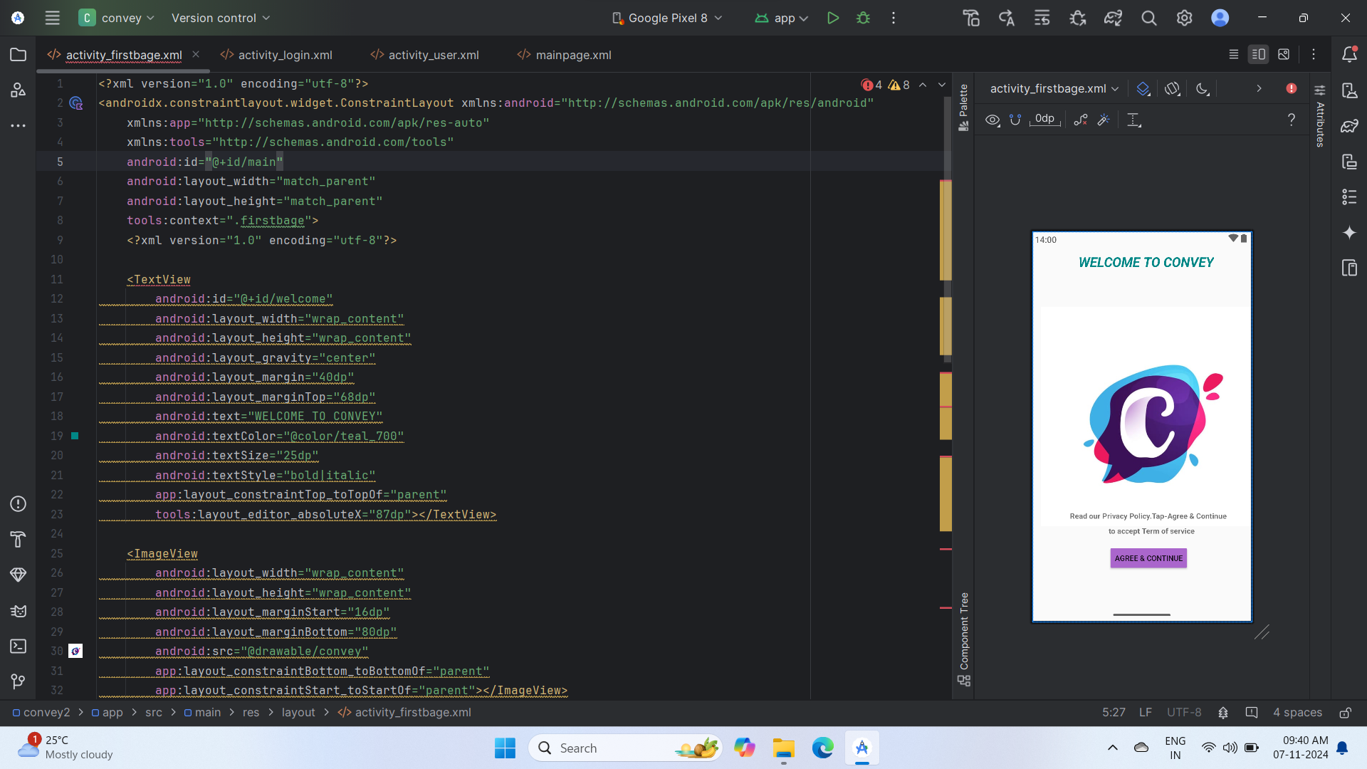
OUTPUT:

Slide 22
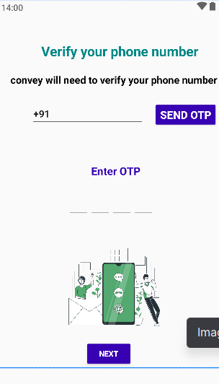

Slide 23
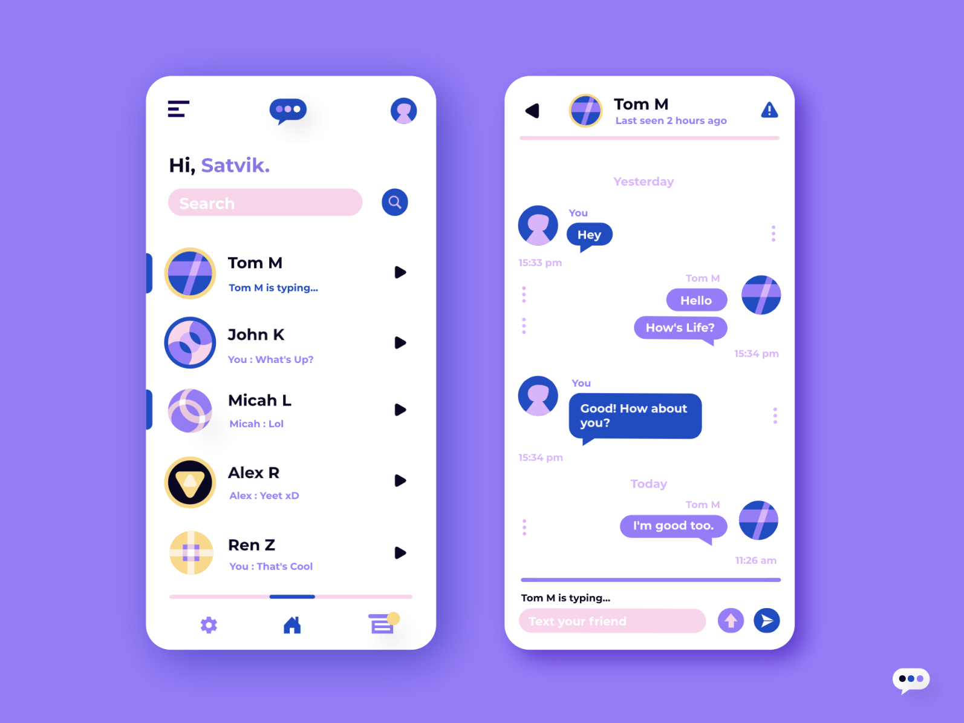

Slide 24
THANKS TO ALL MY SPECIAL THANKS TO MS.B.PAVITHRA MAM THANK YOU MAM THANKS TO TEAM MEMBERS

